Slide 1

SCM 649 Final Project Review
Modelling Popular Music

Slide 2

Team:
Jessica Martinez
Mohammed Saad
Scott Murray

Slide 3

Project Focus
The purpose of our final group project is to analyze the dataset we obtained from kaggle.com, Spotify API, by running different analysis on the data, and try to predict the future trend of the data. This would help the organization to improve their business methods in real time and give us an insight to this industry.
About the Data
Spotify compiled a database of 228k music tracks.
Numerous variables are present (Popularity, Danceability, Acousticness).
Consisting both quantitative and qualitative data, data cleaning is required.

Slide 4
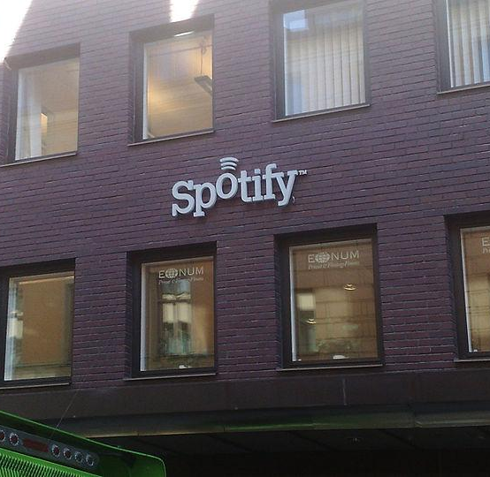
Tools and Techniques
Our project includes statistical modelling techniques and advanced reporting visualizations.
Tools Selected
JMP pro: To clean the data set, and run different analysis on it to see the correlation between different variables. also finally predict the future trend in the data.
Tableau: To create effective dashboards for the data and graphically represent it.

Slide 5
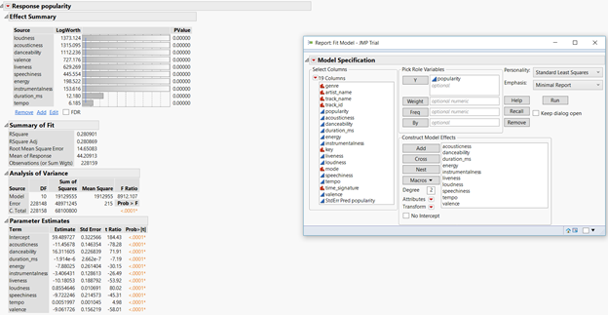
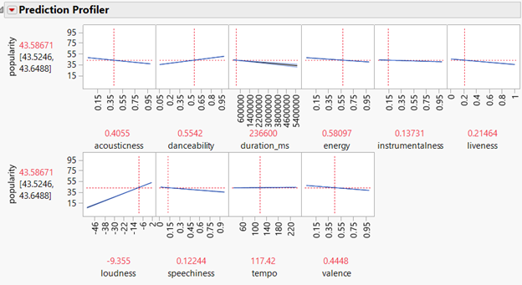
Linear regression on sample data.
Popularity v/s Rest of the data

Slide 6
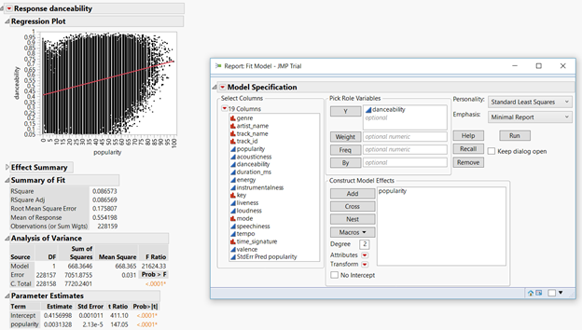
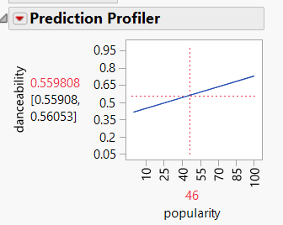
Danceability v/s Popularity

Slide 7
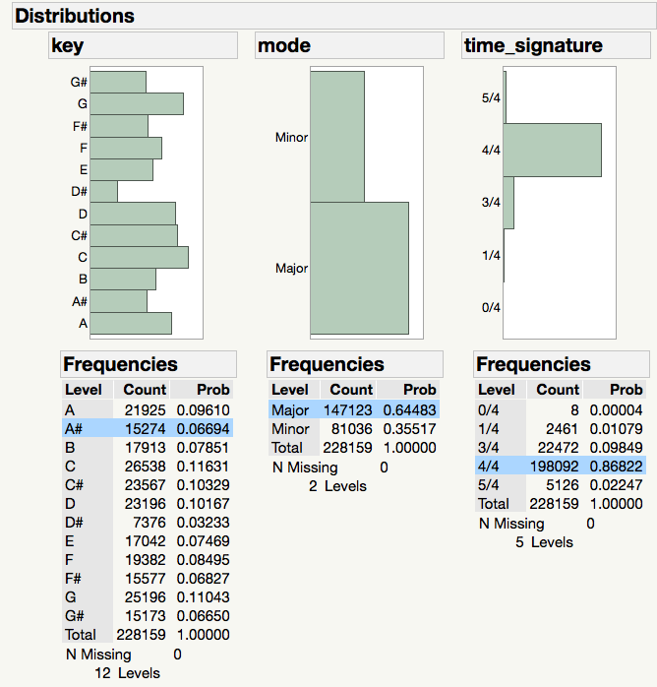
Distributions of key, mode, and time signature
Key=The estimated overall key of the track. Integers map to pitches using standard Pitch Class notation . E.g. 0 = C, 1 = C♯/D♭, 2 = D, and so on. If no key was detected, the value is -1.
Mode=modality (major or minor) of a track, the type of scale from which its melodic content is derived. Major is represented by 1 and minor is 0.
Time Signature=An estimated overall time signature of a track. The time signature (meter) is a notational convention to specify how many beats are in each bar (or measure).
Notes:
Most Popular Key is C
Popular mode is Major
Most popular time signature is 4/4

Slide 8
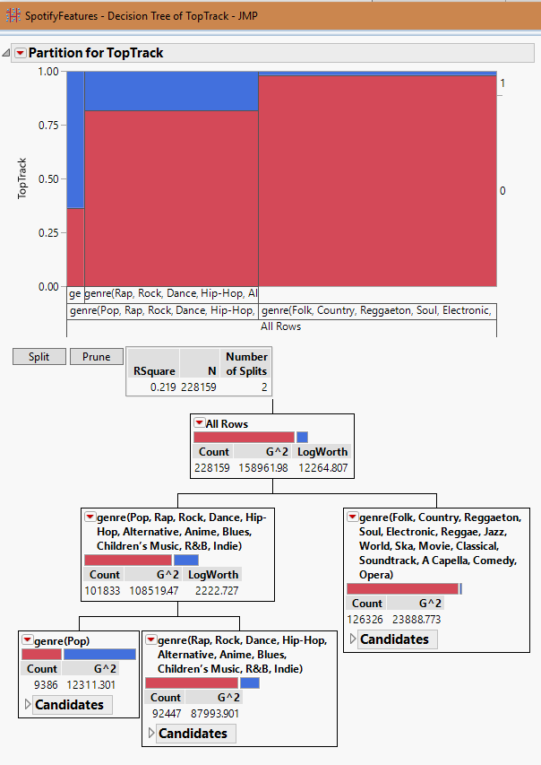
Predicting Popularity
We created a new “TopTrack” attribute. If “Popularity” >= 90% then TopTrack = 1 else TopTrack = 0.
We then ran the dataset through a predictive model (decision tree) with Top Track as the Response and the rest of the attributes as the Factors.
The results indicate that the Pop genre is the best predictor for TopTrack.
Next steps could include an analysis of the Pop genre. What track attributes constitute a Pop song?
Another direction would be to identify the least popular tracks and their predictors. This information could be applied to an avoidance strategy.
Notes:
Most Popular Key is C
Popular mode is Major
Most popular time signature is 4/4

Slide 9



Customer and Deliverables
The primary deliverable for our project information on what makes music popular.
Customer
Our customer is YOU. We will look at the data and let you know deliverables to specific questions regarding the Spotify tracks we analyzed.
Deliverables
Specific questions we will answer based on our findings:
What song is the most popular song in each genre?
Is there a correlation between the most popular song and what key it is in?
Is there a correlation between danceability and energy?
Is there a correlation between danceability and popularity?
Is there a correlation between valence and popularity of the track?
Can track popularity (or lack of) be predicted?

Slide 10
Deliverables (continued)
Attributes Explained:
Key: The estimated overall key of the track. Integers map to pitches using standard Pitch Class notation . E.g. 0 = C, 1 = C♯/D♭, 2 = D, and so on. If no key was detected, the value is -1.
Danceability: Danceability describes how suitable a track is for dancing based on a combination of musical elements including tempo, rhythm stability, beat strength, and overall regularity. A value of 0.0 is least danceable and 1.0 is most danceable.
Energy: Energy is a measure from 0.0 to 1.0 and represents a perceptual measure of intensity and activity. Typically, energetic tracks feel fast, loud, and noisy. For example, death metal has high energy, while a Bach prelude scores low on the scale. Perceptual features contributing to this attribute include dynamic range, perceived loudness, timbre, onset rate, and general entropy.
Valence: A measure from 0.0 to 1.0 describing the musical positiveness conveyed by a track. Tracks with high valence sound more positive (e.g. happy, cheerful, euphoric), while tracks with low valence sound more negative (e.g. sad, depressed, angry).

Slide 11
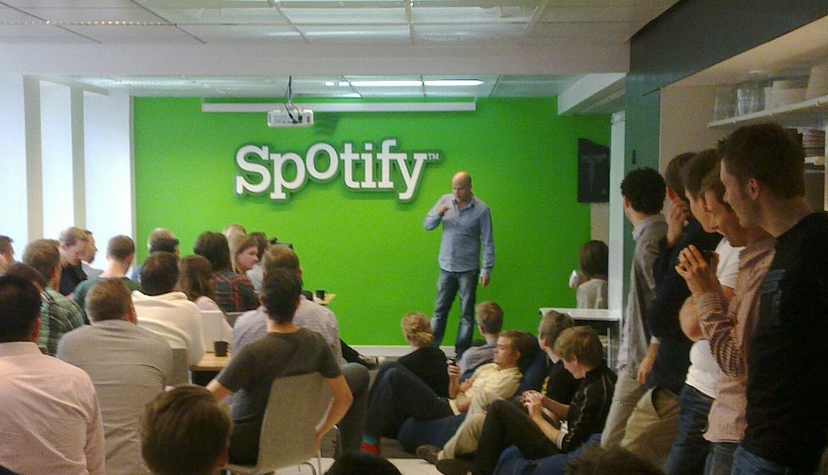




Thank You Questions?

